Slide 1
Tools of Science
Scientific Method
Used for experimentation
Graphing
Visualizing data
Metric System
meter –length
liter – volume
gram – mass
temperature – Celsius, Fahrenheit, Kelvin

Slide 2
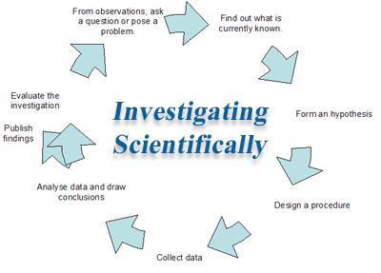
The Scientific Method

Slide 3
Steps for Scientific Method
State the problem in the form of a question
Research and gather information
Form a prediction and present a hypothesis
Test the hypothesis with a controlled experiment
Gather and analyze data
Draw conclusions
Do your results match your hypothesis?

Slide 4
Why Scientific Method?
To reach logically-valid conclusions
Two schools of reasoning
Deductive vs. Inductive
Deductive reasoning involves applying generalized theories to specific situations
Example: “All grandfathers are old men (generally the case, with few exceptions). Harold is old (observation). Therefore, Harold is a grandfather (inference).”

Slide 5
Inductive reasoning makes broad generalizations from specific observations, basically the reverse of deductive reasoning
Example: “The coin I pulled from the bag is a penny (observation). The 2nd coin is a penny (same). A third coin from the bag is also a penny (same). Therefore, all the coins in the bag are pennies (inductive inference).”

Slide 6
The Experiment
Two groups
Control – all conditions are kept the same
Experimental – all conditions kept the same except for the variable being tested
Only one can be tested at a time
The condition that is changed is the independent variable
The condition that results from changing the independent variable is the dependent variable

Slide 7
Examples
Mario studied how far room temperature water would spurt out of a plastic milk carton when 5mm. holes were punched at different heights from the bottom of the container.
A math teacher wanted to know if listening to music while studying would increase test scores.

Slide 8
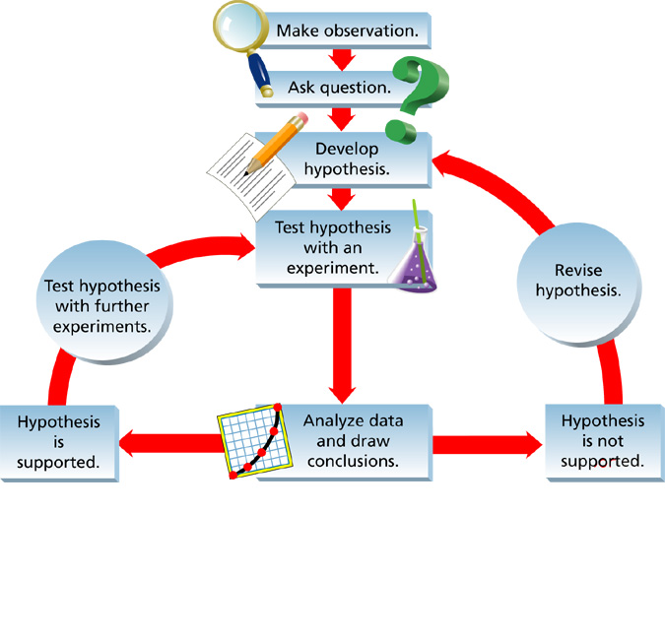
What Could Happen:
Option 1: the data does support the hypothesis.
In “good science”, researchers always repeat their experiments to make sure that the results are consistent.

Slide 9
What Also Could Happen:
Option 2: the data does NOT support the hypothesis.
Often the case in experimentation…
Researchers usually fail to reach a credible claim the first time and must repeatedly revise their plans.

Slide 10
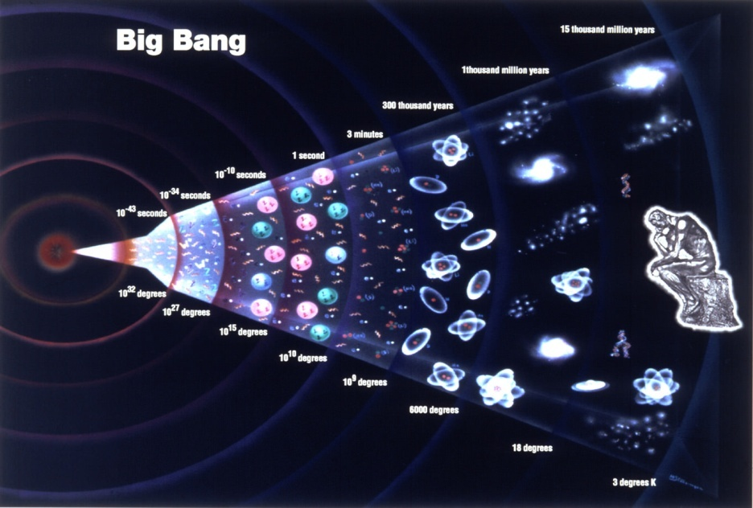
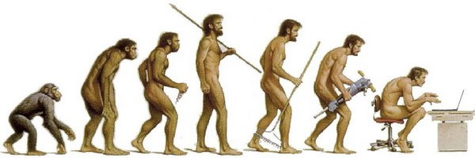
How Theories Develop
A hypothesis that is supported by many separate experiments over a long period of time is known as a theory
Examples:
Theory of Evolution
Big Bang Theory

